Slide 1
C# & .NET Framework
Chapter 21:
Programming With Windows Forms Control

Slide 2
Review
MenuStrips and ContextMenuStrips
StatusStips
MDI applications

Slide 3
Chapter 21: Objectives
Working with the Basic Controls
Configuring the Tab Order.
Setting the Form’s Default Input Button
Working with More Exotic Controls
Dynamically Positioning Windows Forms Controls.

Slide 4
Basic Controls
Label, TextBox, and MaskedTextBox
Button
CheckBox, RadioButton, and GroupBox
CheckedListBox, ListBox, and ComboBox
MonthCalendar, TabControl, TrackBar, WebBrowser

Slide 5
Label, TextBox, and MaskedTextBox
MaskedTextBoxes
A masked text box allows to specify a valid sequence of characters that will be accepted by the input area (Social Security number, phone number with area code, zip code, or whatnot).
The mask is used to test against (termed a mask expression) is established using specific tokens embedded into a string literal.
Mask Token | Description
0 | Represents amandatory digit with the value 0–9
9 | Represents an optional digit or a space
L | Required letter (in uppercase or lowercase), A–Z
? | Optional letter (in uppercase or lowercase), A–Z
, | Represents a thousands separator placeholder
: | Represents a time placeholder
/ | Represents a date placeholder
$ | Represents a currency symbol

Slide 6
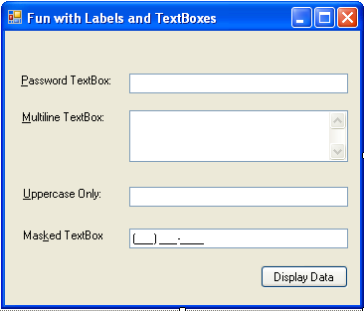
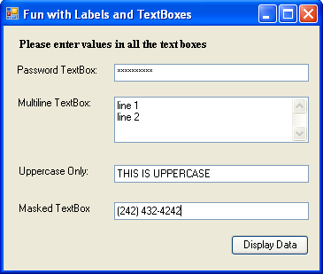
Label, TextBox, and MaskedTextBox Demo (Ch_21 Code\LabelsAndTextBoxes)

Slide 7
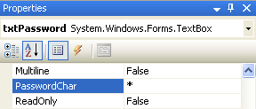
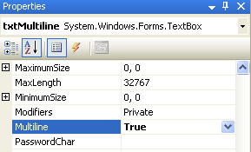
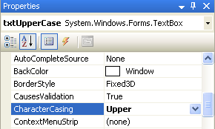
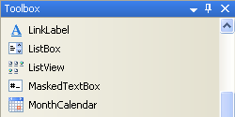
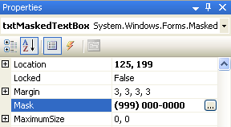

Slide 8
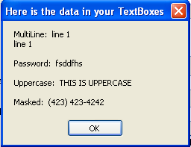
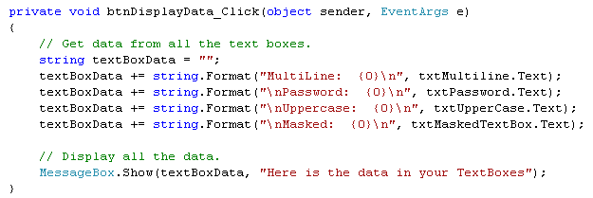

Slide 9
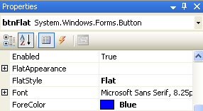
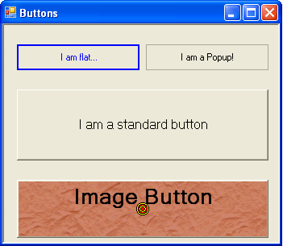
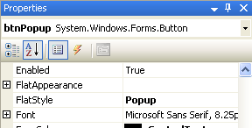
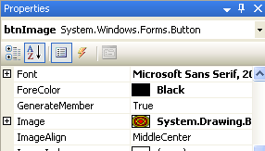
Button Demo (Ch_21 Code\Buttons)

Slide 10
CheckBoxes, RadioButtons, and GroupBoxes
CheckBox Properties
Property | Description
Appearance | Configures the appearance of a CheckBox control, using the Appearance enumeration.
AutoCheck | Gets or sets a value indicating if the Checked or CheckState value and the CheckBox’s appearance are automatically changed when it is clicked.
CheckAlign | Gets or sets the horizontal and vertical alignment of a CheckBox on a CheckBox control
Checked | Returns a Boolean value representing the state of the CheckBox (checked or unchecked).
CheckState | Gets or sets a value indicating whether the CheckBox is checked, using a CheckState enumeration rather than a Boolean value.
ThreeState | Configures whether the CheckBox supports three states of selection (as specified by the CheckState enumeration) rather than two

Slide 11
CheckedListBoxes
Inherits most of its functionality from the ListBox type.
Fun with ComboBoxes
A ComboBox allows users to make a selection from a well-defined set of possibilities.
The ComboBox type is unique in that users can also insert additional items.
The Tab Order Wizard

Slide 12
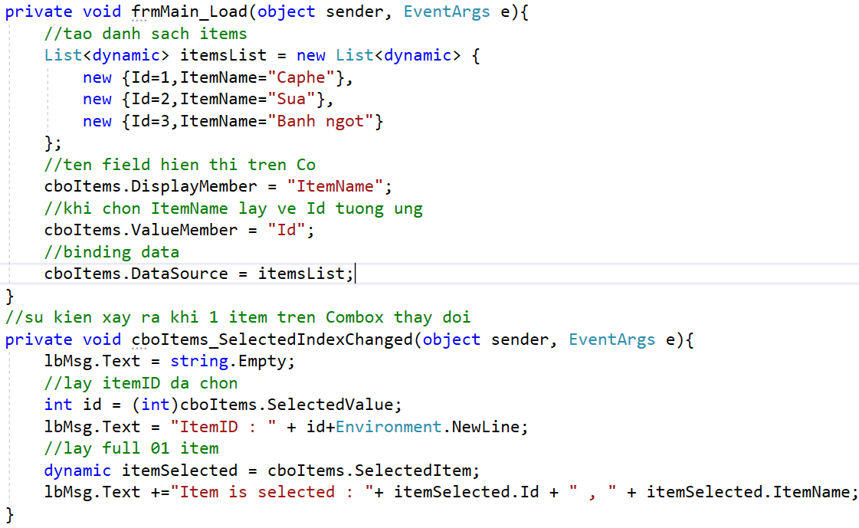
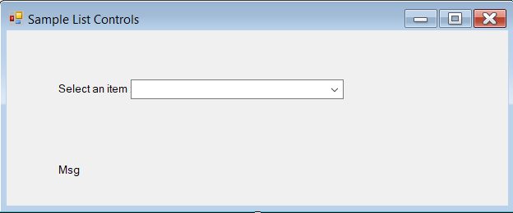

Slide 13

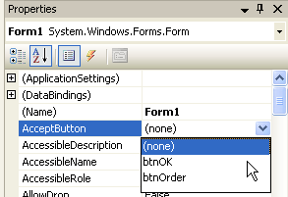
The Form’s Default Input Button
Many user-input forms (especially dialog boxes) have a particular Button that will automatically respond to the user pressing the Enter key.

Slide 14
Other Controls
MonthCalendar
ToolTip
TabControl
TrackBar
Panel
UpDown controls
ErrorProvider
TreeView
WebBrower

Slide 15

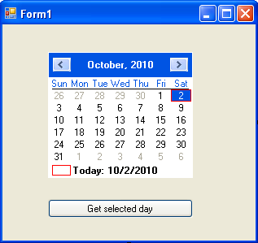
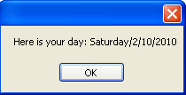
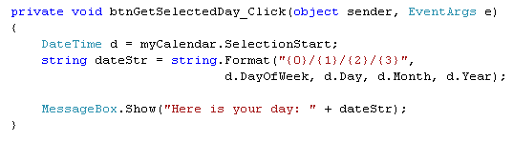
MonthCalendar Demo

Slide 16
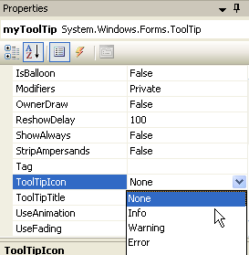
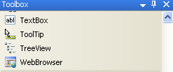
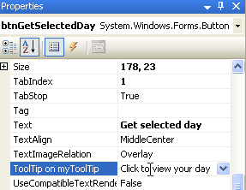
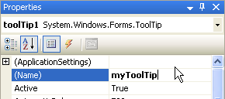
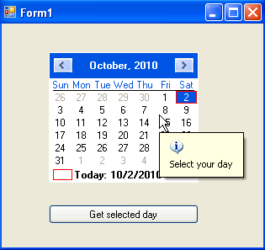
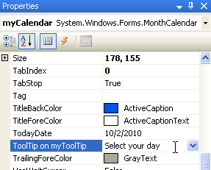
Tooltip Demo
2
1
4
3
5

Slide 17
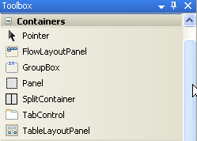
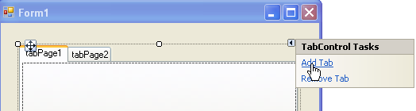
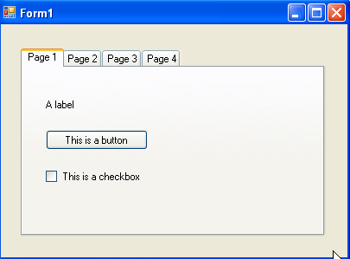
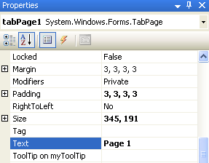
TabControl Demo
1
2
4
3

Slide 18

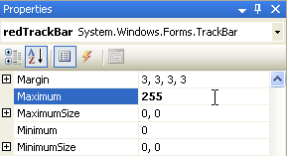
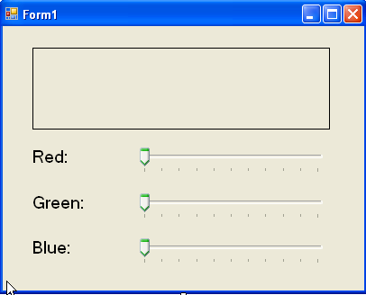
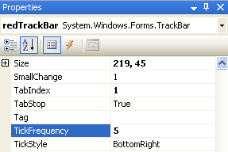
TrackBar Demo

Slide 19
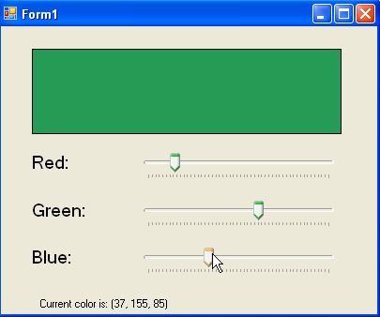
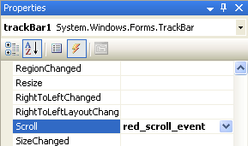
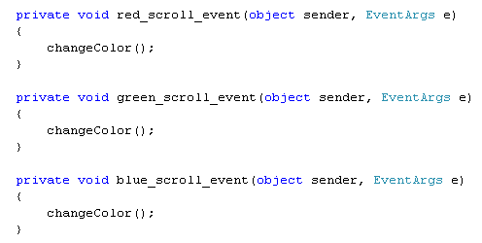
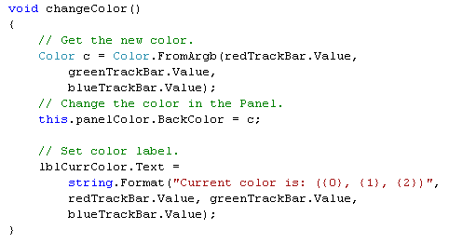
TrackBar Demo

Slide 20
ErrorProvider Control
ErrorProviders
Most Windows Forms applications will need to validate user input in one way or another.
If you wish to support this type of input validation, set the CausesValidation property to true or false (the default is true).
Property | Description
AlwaysBlink | Causes the error icon to blink when the error is displayed
BlinkIfDifferentError | Causes the error icon to blink only if the error icon is already displayed
NeverBlink | Indicates the error icon never blinks

Slide 21
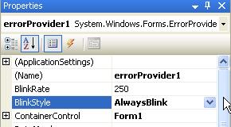
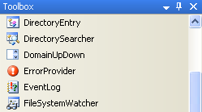
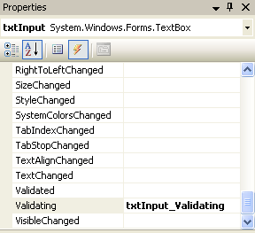
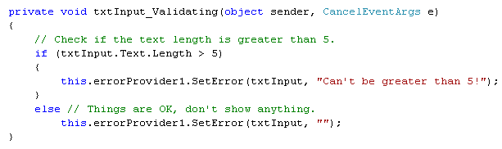
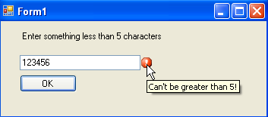
ErrorProvider Demo
2
1
4
3

Slide 22

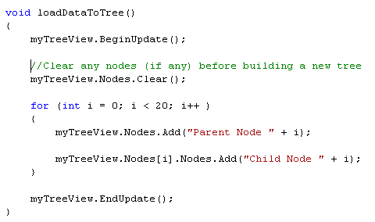
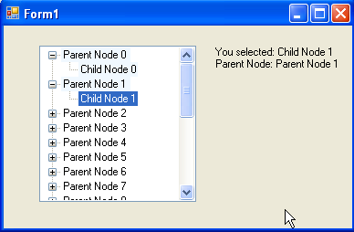
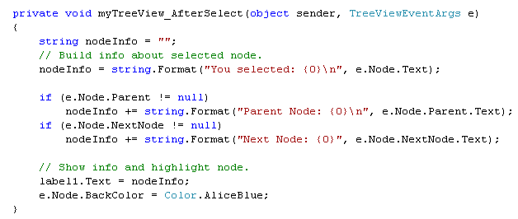
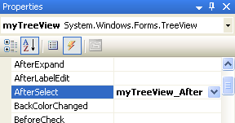
TreeView Demo

Slide 23


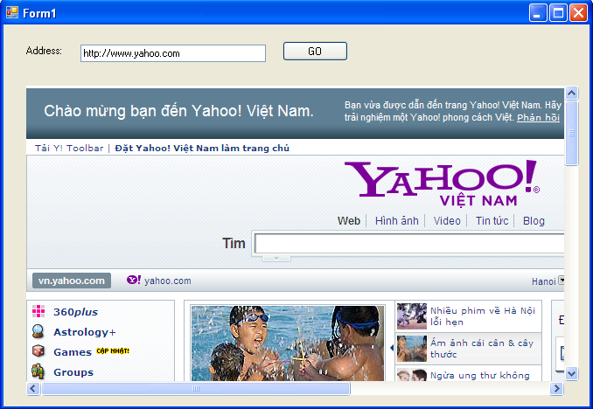
WebBrowser Demo

Slide 24
Dynamically Positioning Windows Forms Controls
The Anchor Property
The Anchor property is used to define a relative fixed position in which the control should always be rendered.
The Dock Property
Another aspect of Windows Forms programming is establishing the docking behavior of your controls.
If you so choose, you can set a widget’s Dock property to configure which side (or sides) of a Form the widget should be attached to.
Example: AnchoringControls

Slide 25
Dynamically Positioning Windows Forms Controls
Table and Flow Layout
.NET 2.0 offers an additional way to control the layout of a Form’s widgets using one of two layout managers.
The TableLayoutPanel and FlowLayoutPanel types can be docked into a Form’s client area to arrange the internal controls.

Slide 26
Summary
Label, TextBox, and MaskedTextBox
Button
CheckBox, RadioButton, and GroupBox
CheckedListBox, ListBox, and ComboBox
MonthCalendar, TabControl, TrackBar, WebBrowser

Slide 27
Chapter 21: Q & A

